Slide 1
April 4th, 2023 is Election Day!

Slide 2
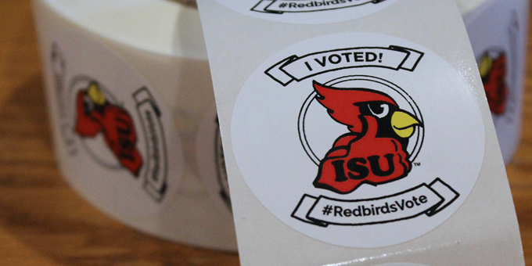
Voting Is Civic Engagement
Civic Engagement is a core value of Illinois State University.
We strive to:
prepare students to be informed and engaged global citizens
encourage students to be ethical leaders who will craft, promote, and further positive goals for the betterment of society
view civic engagement as a lifelong responsibility

Slide 3
Are you registered to vote?
Yes
No
I don’t know
Have you moved since you last registered or voted?
Yes
You need to change your address of record. Visit IllinoisState.edu/vote to learn how!
No
Awesome! You are all set.
Use the Illinois Registration Lookup to check.
To learn how to register, visit IllinoisState.edu/vote!
The LAST day to register to vote online in Illinois is March 19th at 11:59PM!

Slide 4
Ways To Vote
Early Voting
In-Person at the Polls
By Mail
Request a mail-in ballot from where you are registered
Complete your ballot
Avoid the lines!
McLean County Government Center
February 23rd-April 3rd
Find your polling place at tinyurl.com/isuvotes
Request MUST be sent by March 30th
Ballots will be mailed beginning February 23rd
Mail your ballot back by April 4th (or earlier!)
Need a stamp?
Visit the Center for Civic Engagement (300 W. North St, across from CVS) to get a stamp and mail your ballot.
Various times
Or vote at the McLean County Government Center
6am-7pm
Need a ride? Stop by the Center for Civic Engagement on 3/31 anytime from 10am-4pm for a ride to vote early.
Need a ride? Stop by the CCE on April 4th from 10am-4pm for a ride.
APRIL
4

Slide 5
Missed Online Registration? You Can Still Vote!
Illinois is a same-day registration state, so you can register to vote at a polling place.
Register at a polling place during early voting OR on April 4th.
Bring 2 forms of ID that have your name and current, local address.
Students living in the residence halls can use a screenshot of their current address from the ISU Student Service Center as a form of ID.
Acceptable forms of ID:
Passport or military ID
Driver's license or State ID card
College/university/school/work ID
Business mail postmarked to the applicant (including mail sent from ISU)
Library card
Vehicle registration card
Lease, mortgage or deed to the home
Credit or debit card
Social Security, Medicare or Medicaid card
Insurance card
Payroll check/personal check
Voter registration card
Social Security card
Bank statement
Birth certificate
Utility bill in applicant's name

Slide 6
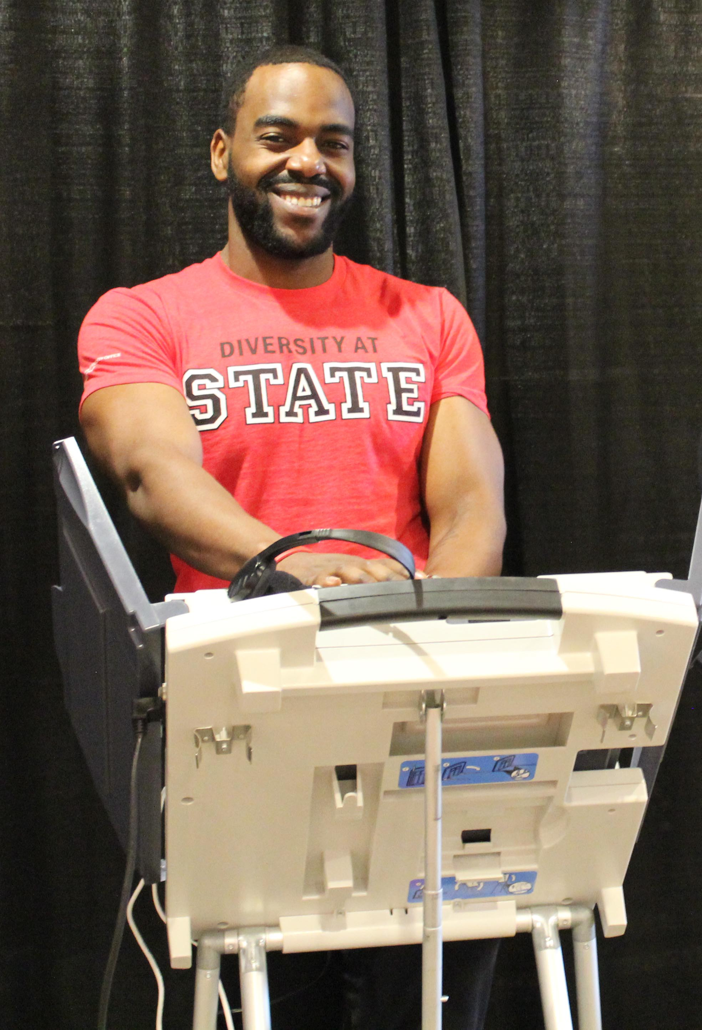
How Do I Know Who To Vote For?
Resources are available through the Redbird Voter Guide to help you know what and who is on the ballot each election.
IllinoisState.edu/Vote
Non-partisan resources are also available for you to explore your political values/ ideology and to help you decide how to cast your vote.

Slide 7
Think Your Vote Doesn’t Matter? It Does!
The United States is a democracy and voting is a core principle that makes democracy happen.
This is one important way to make your voice heard.
Your vote can lead to the creation of public policy that has lasting change in the U.S., your state, and your city.
If you agree with the efforts of current national, state, or local leaders, voting is a way to voice your support.
If you are upset with national, state, or local leaders, voting can usher in changes.

Slide 8
Not Eligible to Vote? EVERY Voice Counts!
Visit thelovevote.org to share your story and move voters with love.
Use your platforms to amplify issues that matter to you.
Encourage your professors to have discussions around the issues, candidates, and civic education.
Attend campus debates or host an in-person or virtual watch party.
Visit the Redbird Voter Guide for more ways to make your voice count!

Slide 9
Voter Restoration
Resources and information on the historical and current fight for the right to vote
The Power of Youth Vote
Tribal Communities Fighting to Vote
The Latinx Voting Movement
Voter Restoration and the War on Drugs
Black America and the Evolution of Voter Suppression
The 19th Amendment and Women of Color
The Century-Long Fight: The Black Sorority Movement for Voting Rights
Voting for All: Access and Accommodation
LGBTQ+ Voting and Civil Rights

Slide 10
Contact Us With Any Questions!
CCE Website: CivicEngagement.IllinoisState.edu
Redbird Voter Guide: IllinoisState.edu/Vote
(309) 438-1100, CivicEngagement@IllinoisState.edu
300 W. North St., Normal (across from Watterson Dining)
Use #RedbirdsVote on social media!
RedbirdImpact
Center for Civic Engagement

